Slide 1


Containerizing Applications
Build, ship and run any application anywhere

Slide 2
Agenda
Docker Terminologies
Basic Commands
Introduction to Dockerfile
Dockerfile Instructions
Best Practices for writing Dockerfiles
Working with Images
Distributing Images on Docker Hub
Running a service in a Container

Slide 3
Terminology : Docker Client and Docker Daemon
Docker engine is a client – server application
Docker Client takes user inputs and sends them to the daemon
Docker Daemons listens to docker API and manages resources. Daemon builds, runs and distributes containers
Client and Daemon can run on the same host or on different hosts
Source: Docker

Slide 4
Terminology : Image, Container and Service
IMAGE
Read only template to create containers
Built by you or other Docker users
Stored in Docker Hub or your local registry
CONTAINER
Running instance of the image
You can connect a container to one or more networks, attach storage to it, or even create a new image based on its current state.
SERVICE
Services allow to scale containers across multiple Docker daemons,
By default, the service is load-balanced across all worker nodes

Slide 5
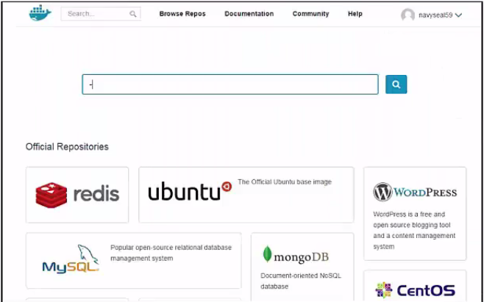
Terminology : Docker hub
Docker Hub is a public registry that contains a large number of images available for your use

Slide 6
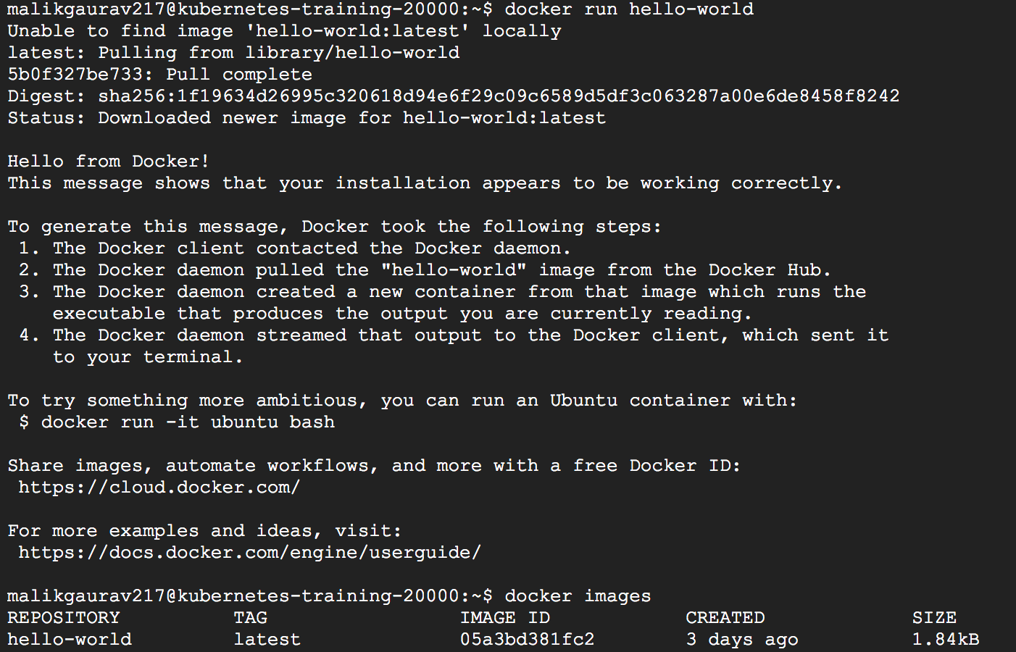
Docker Commands
Lets start by checking the docker version installed
$ docker -v
Check if the docker installation is good by running
$ docker run hello-world

Slide 7
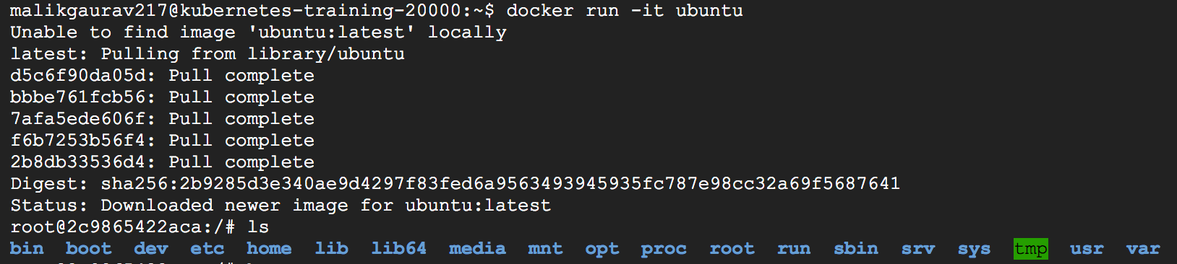
Docker Commands
We can check the list of images in the local registry
$ docker images
To run an image use
$ docker run –it ubuntu

Slide 8
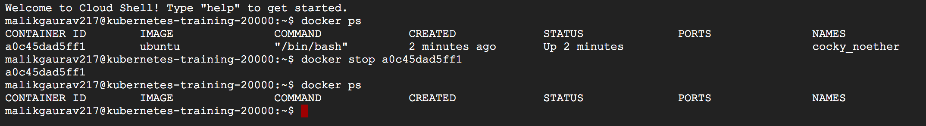
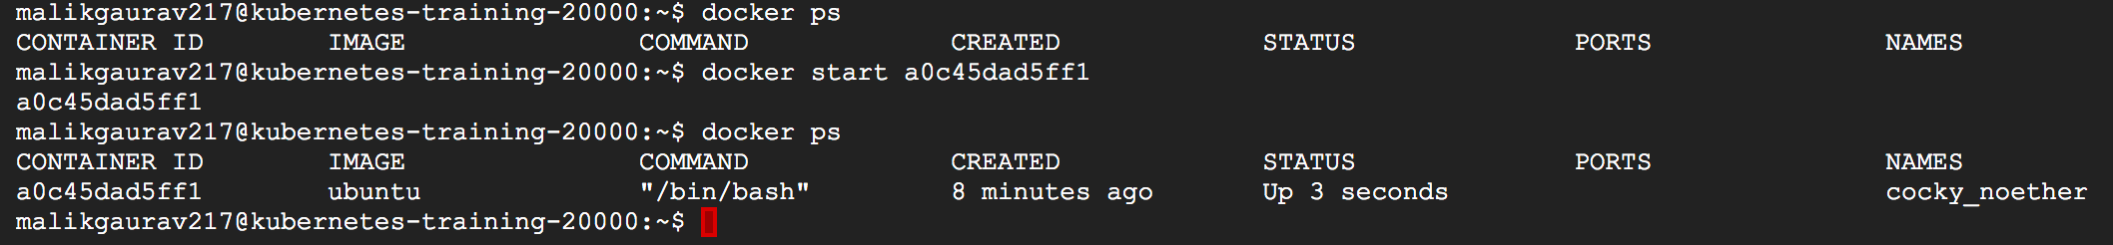
Docker Commands
Check all running containers by using
$ docker ps
Stop a container
$ docker stop <containerid>
Start a container
$ docker start <imageid>

Slide 9
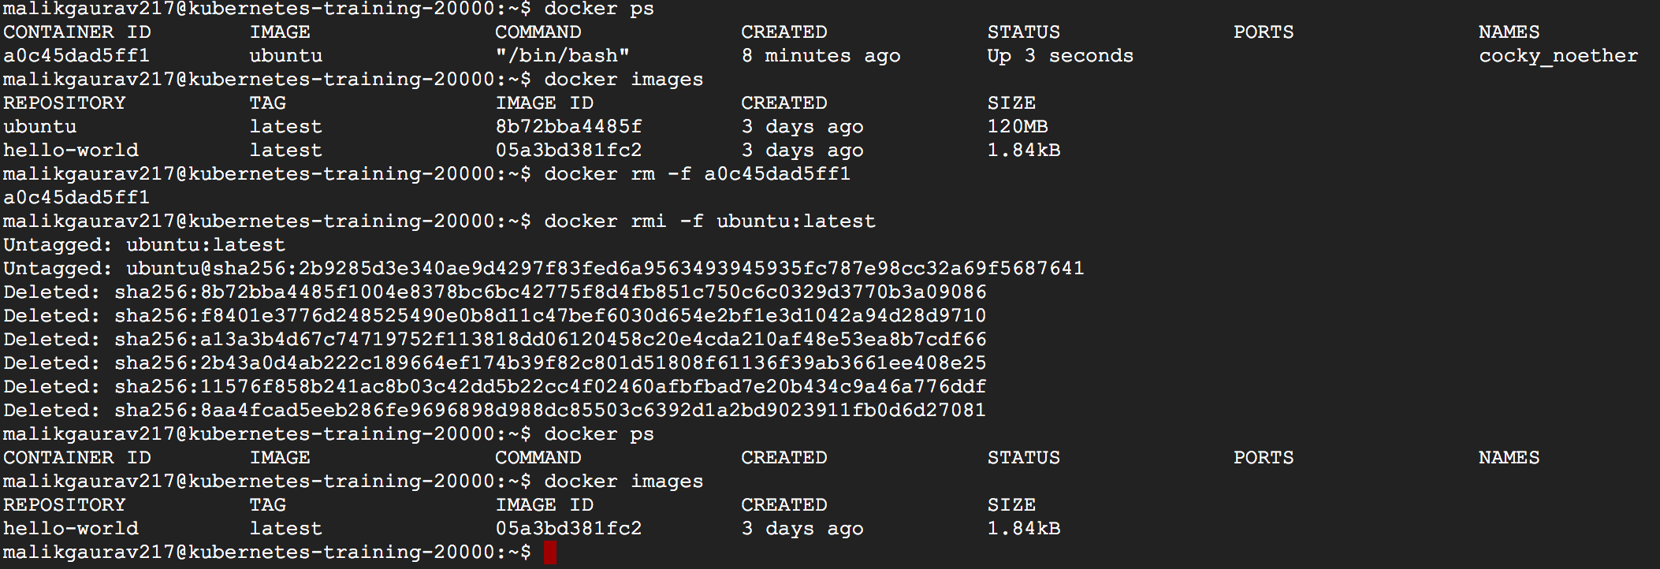
Docker Commands
Remove a container
$ docker rm –f <containerid> or. $ docker rm –f <container-name>
Remove an image
$ docker rmi –f <imageid>

Slide 10
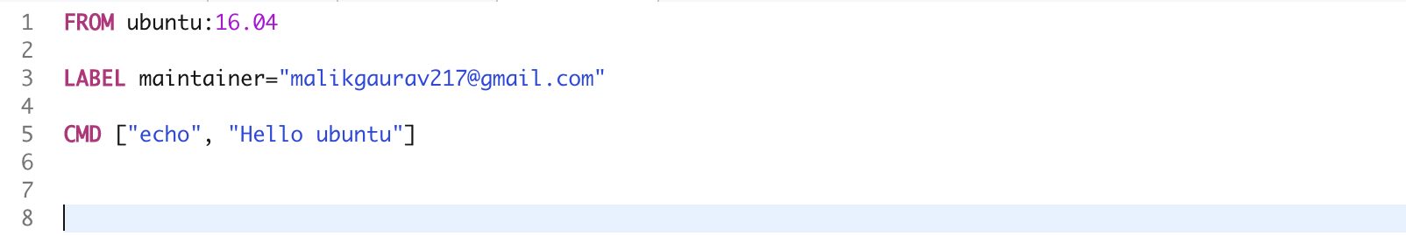
Introduction to dockerfile
Docker can build images automatically by reading the instructions from a Dockerfile.
Dockerfile is a text document that contains all the commands a user could call on the command line to assemble an image. Using docker build users can create an automated build that can execute several command-line instructions in succession.
# Comment
INSTRUCTION arguments

Slide 11
Dockerfile Instructions
ENV - can be used to declare variables. The declared variables can be used in Dockerfile either with $variable_name or ${variable_name}
ENV foo /bar
WORKDIR $foo #WORKDIR /bar
FROM - initializes a new build stage and sets the Base Image for subsequent instructions. A valid Dockerfile must start with a FROM instruction.
FROM <image>[:<tag>]
FROM ubuntu:16.04
RUN – execute commands in a new layer on top of the current image and commit the results. The resulting committed image will be used for next step in the Dockerfile
RUN <command>
RUN [“executable”, “param1”, “param2”]

Slide 12
Dockerfile Instructions
CMD - the main purpose of a CMD is to provide defaults for an executing container. There can only be one CMD instruction in a Dockerfile. If you list more than one CMD then only the last CMD will take effect
CMD [“java”, “-jar”, “myservice.jar”]
LABEL – adds metadata to an image. A LABEL is a key-value pair.
LABEL <key>=<value>
LABEL version=“1.0”
LABEL owner=“john.smith”
EXPOSE – informs Docker that the container listens on the specified network ports at runtime.
EXPOSE <port> [<port>…]
EXPOSE 8080

Slide 13
Dockerfile Instructions
ADD – this copies new files, directories or remote files from <src> and adds them to the filesystem of the image at the path <dest>
ADD <src> <dest>
ADD pom.xml /pom.xml
WORKDIR– sets the working directory for any RUN, CMD, ENTRYPOINT and ADD instructions that follow it in the Dockerfile.
WORKDIR /a
RUN pwd # will print /a

Slide 14
Best Practices for writing Dockerfiles
Use a .dockerignore file – to exclude files or directories
Containers should be immutable – run and destroy
Avoid installing unnecessary packages – to reduce dependency, build size and time
Sort multi-line arguments – to avoid duplication of packages
Build Cache – disable build cache to make new image for every build
Build Every Time– to reuse previous builds latest for debugging or testing
Build variables
RUN-only environment variables - need an environment variable set during a RUN block
One container, One responsibility, One process
Store share data in volumes

Slide 15
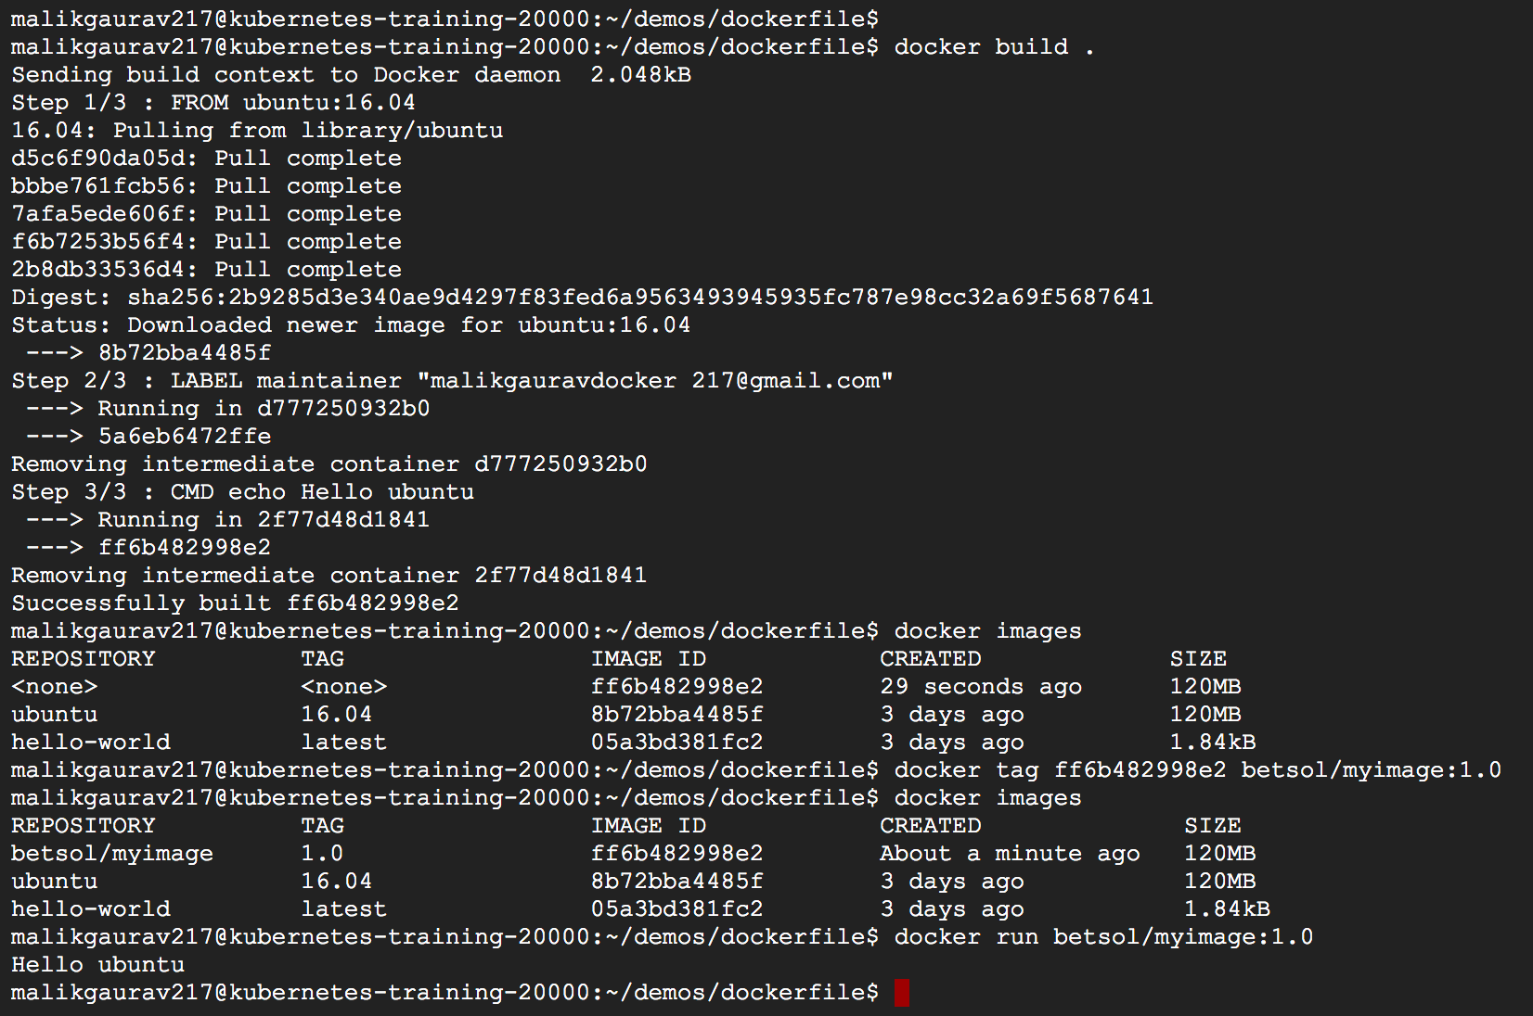
Running the docker build
Create a new custom image using the docker file using
$ docker build .

Slide 16
Running the docker build
Lets tag the new image
$ docker tag <image-id> <tag-name>:<version>
Lets run the new image and we should see “Hello ubuntu” Getting printed on the console
$ docker run <image-name>

Slide 17
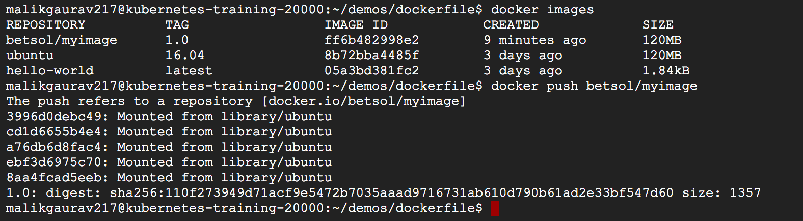
Pushing the images to docker hub
Lets push the image to the docker hub repository using
$ docker push
Note :
In order to be able to push, we need to login to the docker hub using docker id and passoword
$ docker login –u <dockerid> -p <password>

Slide 18
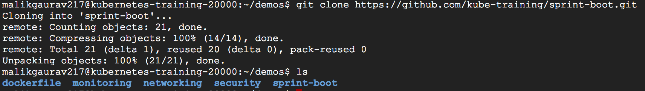
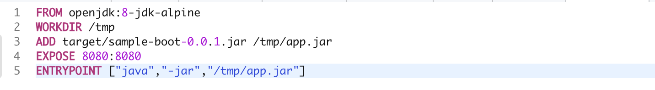
Deploying a service in a container
Containerize and deploy a simple “hello-world” spring boot application.
Lets grab the code onto our docker server
$ git clone https://github.com/kube-training/sprint-boot.git
Add docker configuration via Dockerfile

Slide 19
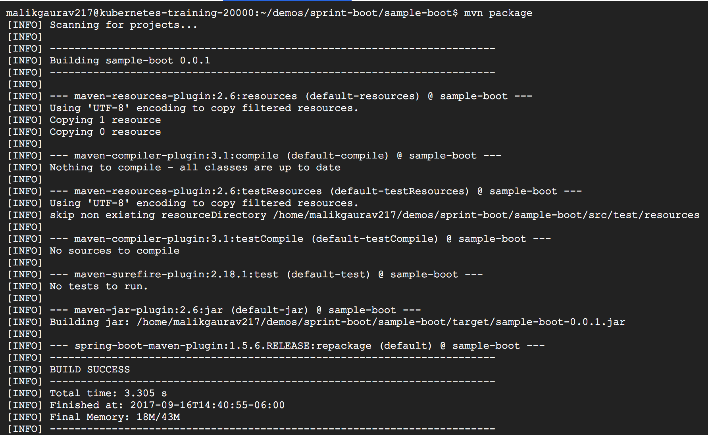
Deploying a service in a container
Before creating the image – create an executable jar
$ mvn package

Slide 20
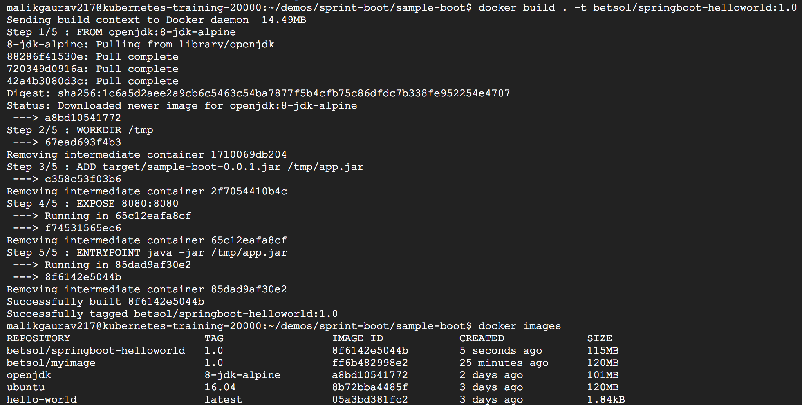
Deploying a service in a container
Create an image
$ docker build . –t betsol/springboot-helloworld

Slide 21
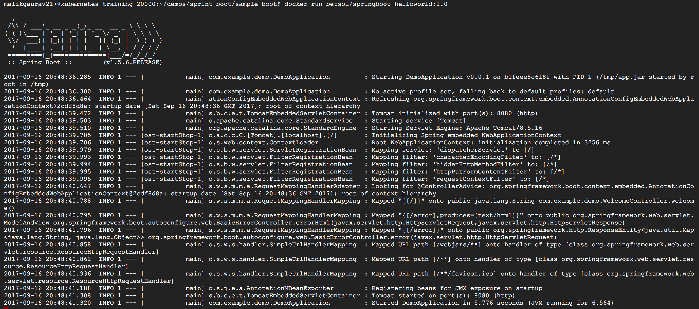
Deploying a service in a container
Run the image to deploy the spring boot application
$ docker run –p 8080:8080 betsol/springboot-helloworld:1.0
Notes:
docker run -e "SPRING_PROFILES_ACTIVE=prod" -p 8080:8080 -t springio/gs-spring-boot-do

Slide 22


